Slide 1

Lodging Analytics
Amit, Nick, Manu and Jag

Slide 2
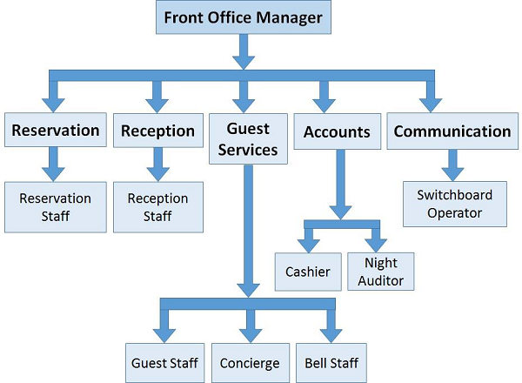
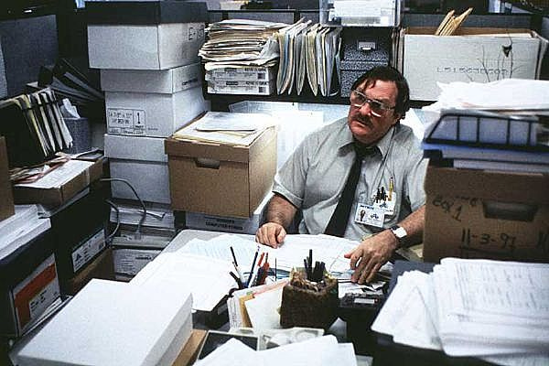

Big Corporations Vs Small Business owner

Slide 3
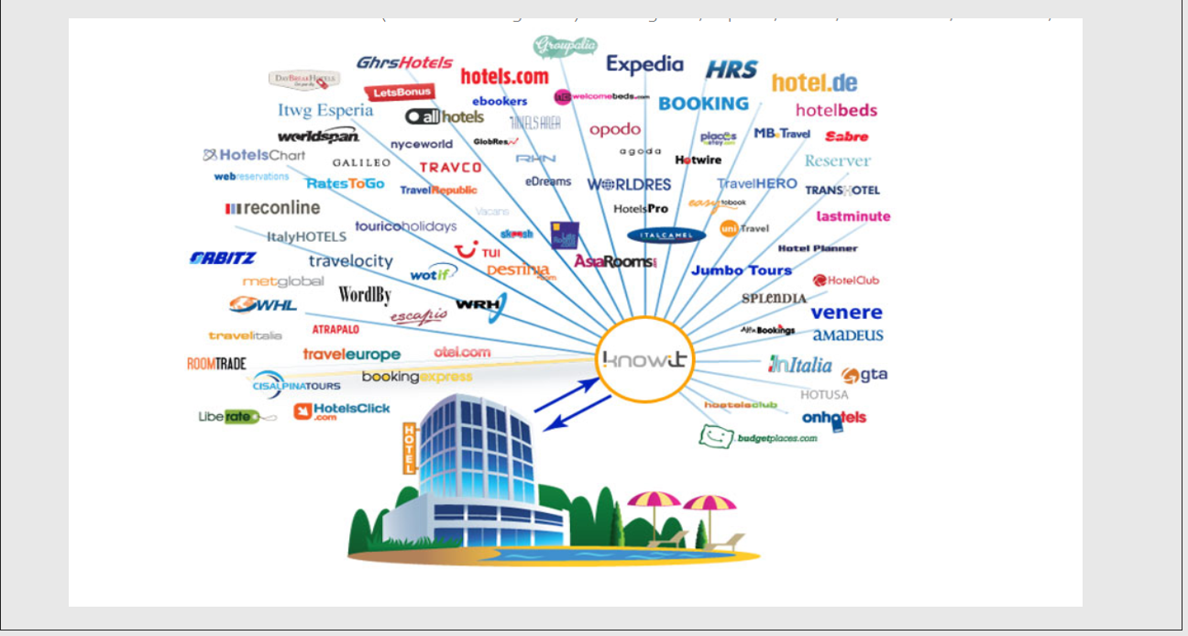
Hotel room is a perishable commodity
Right Room, Right Time & Right Customer

Slide 4
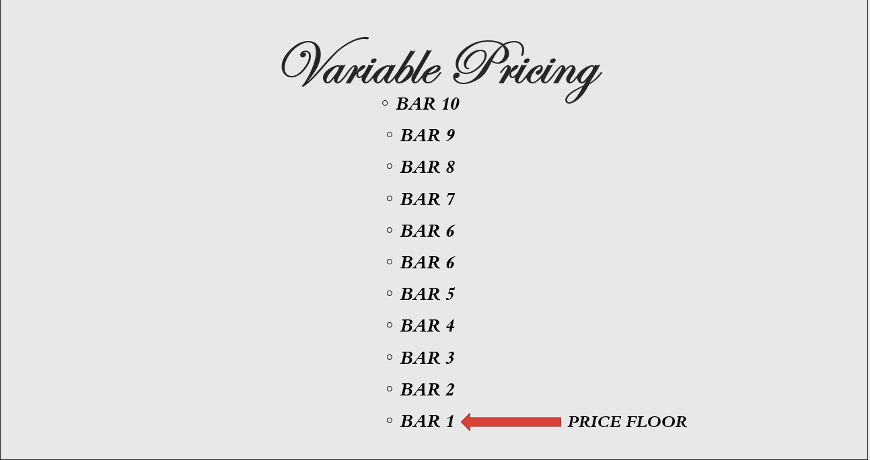
Understanding the model

Slide 5
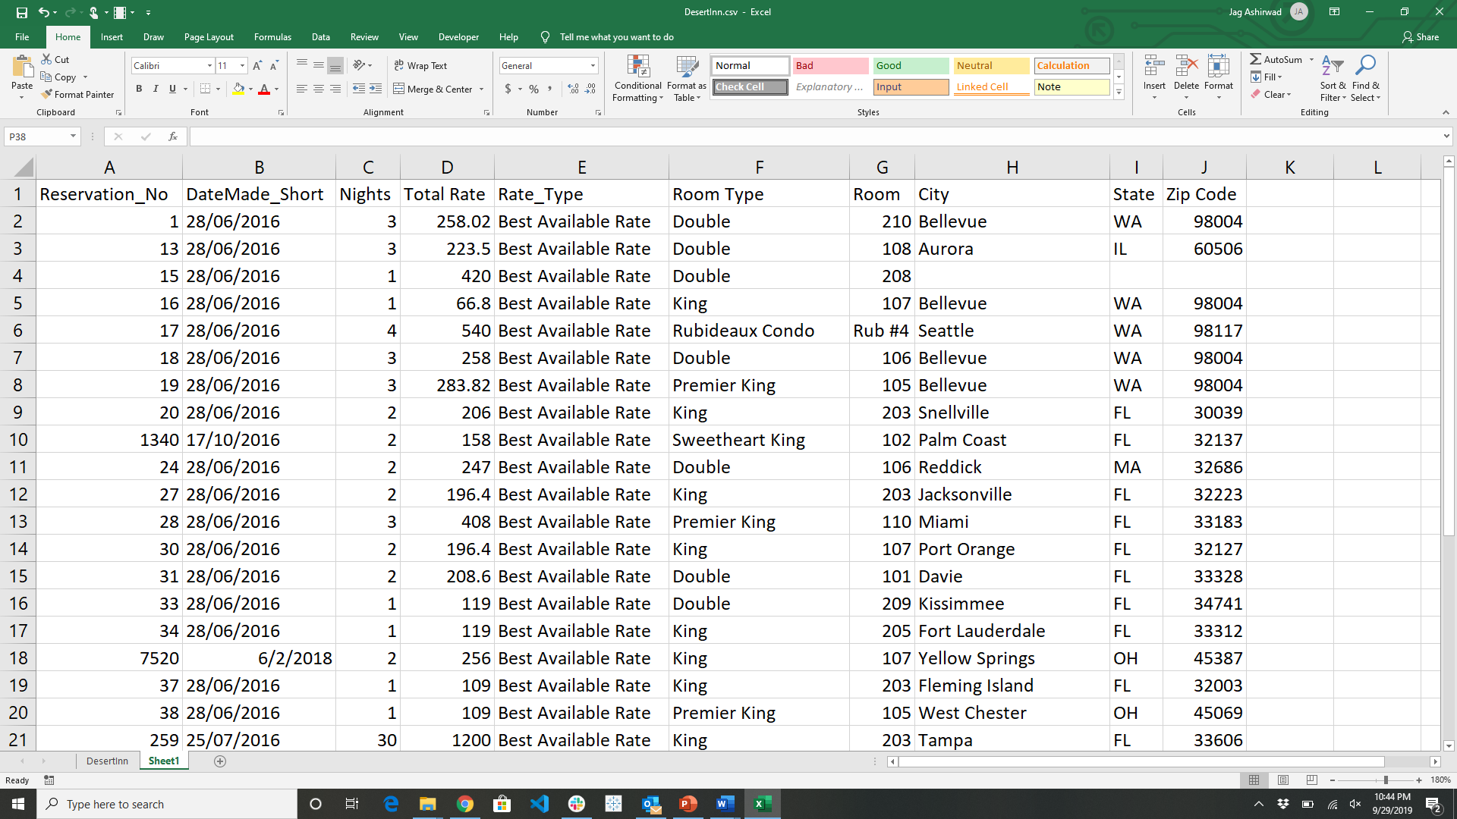
Data

Slide 6
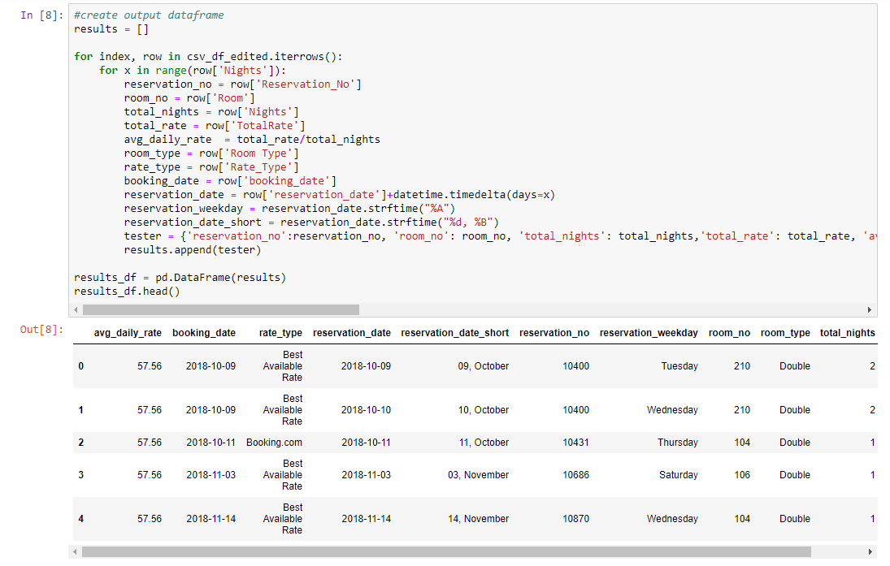
Clean up

Slide 7
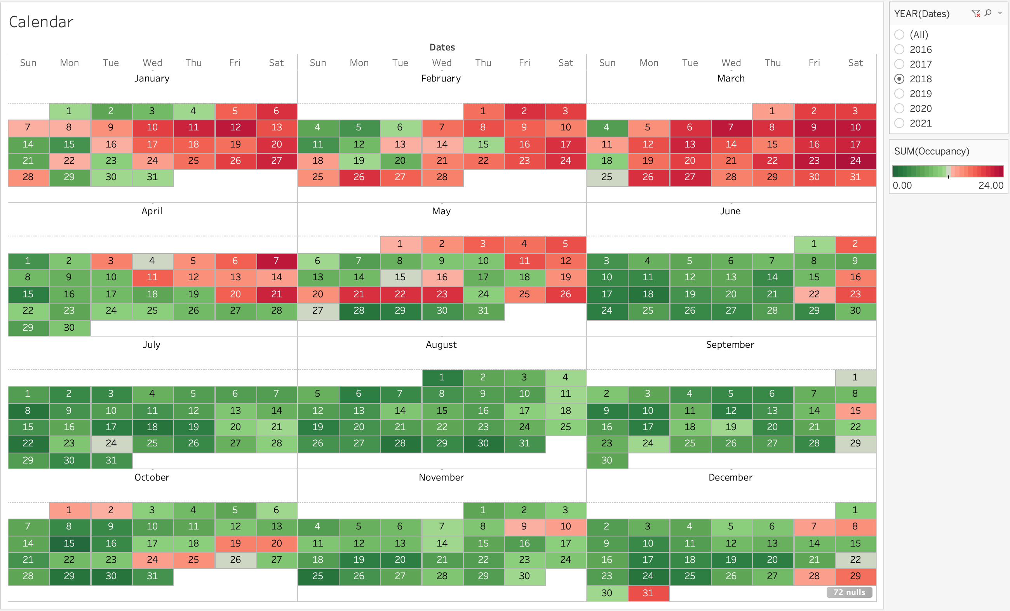
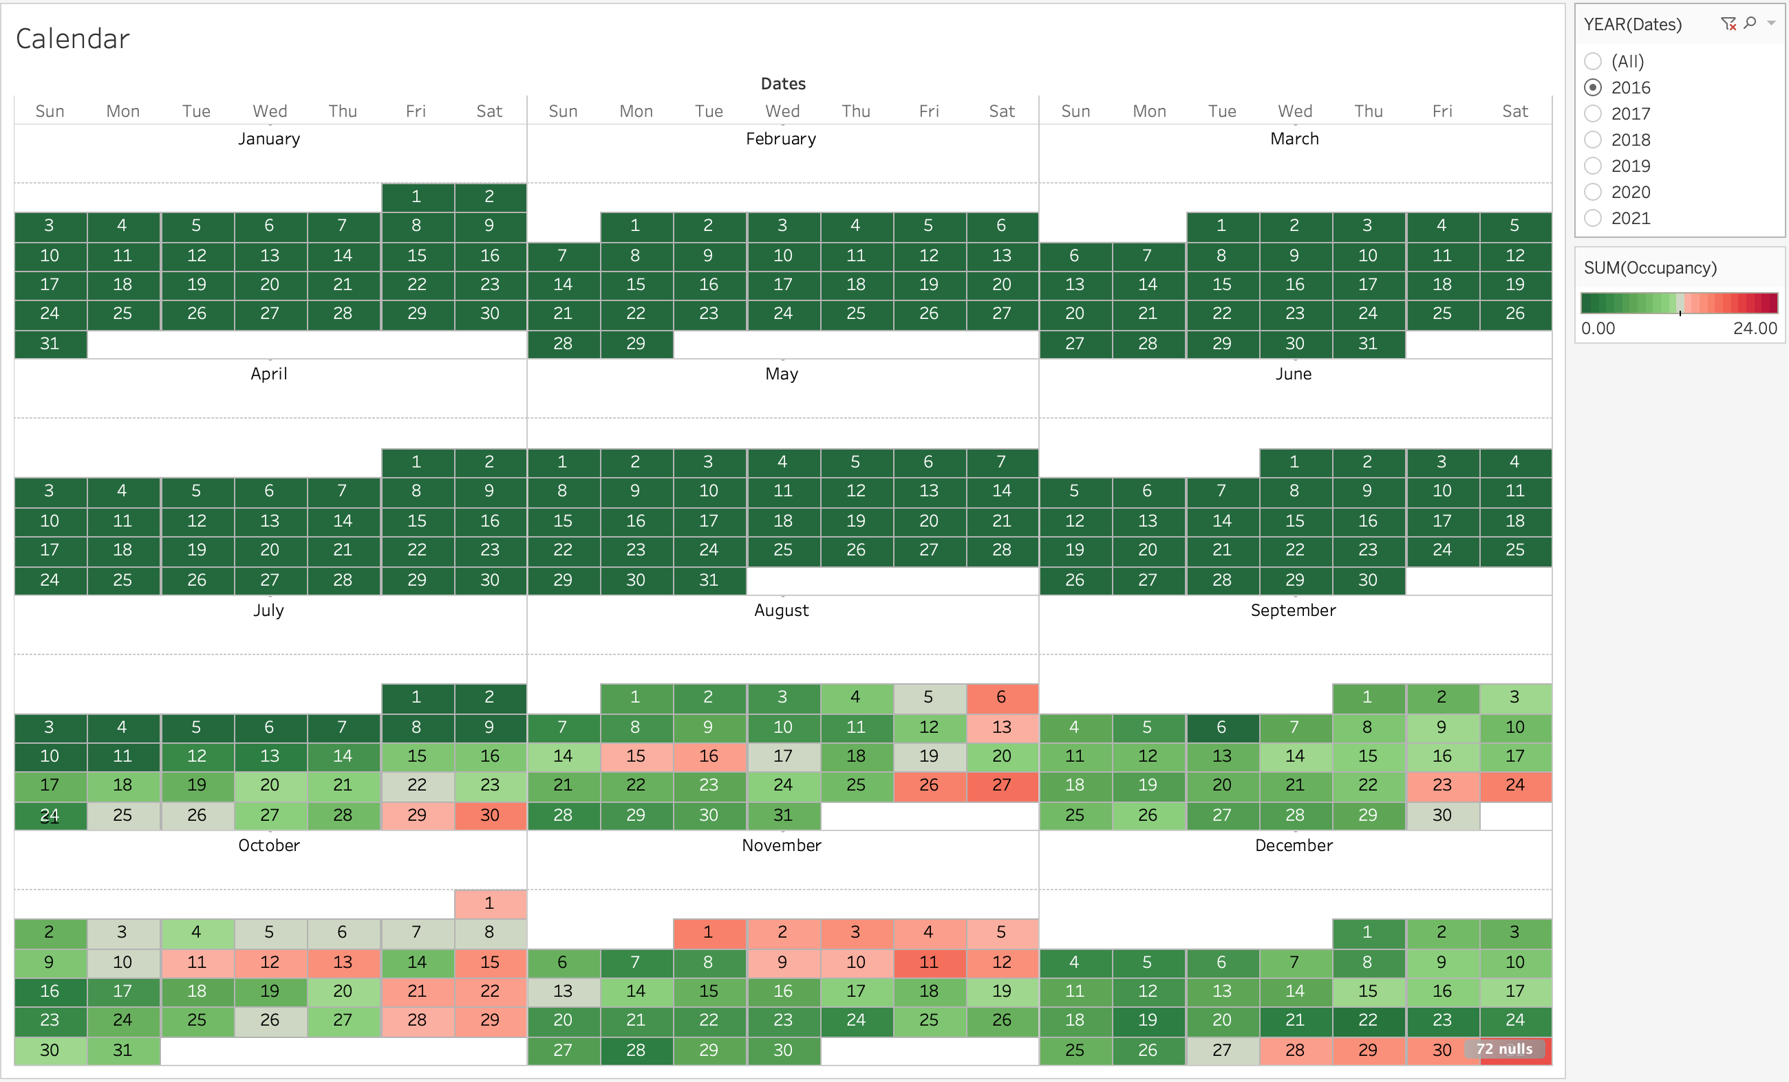
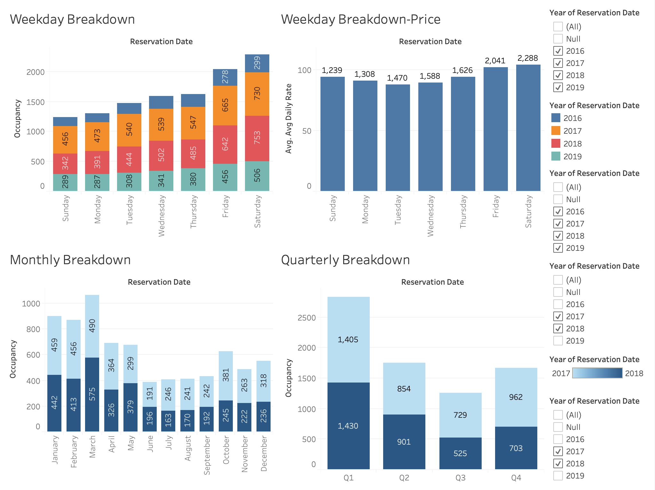
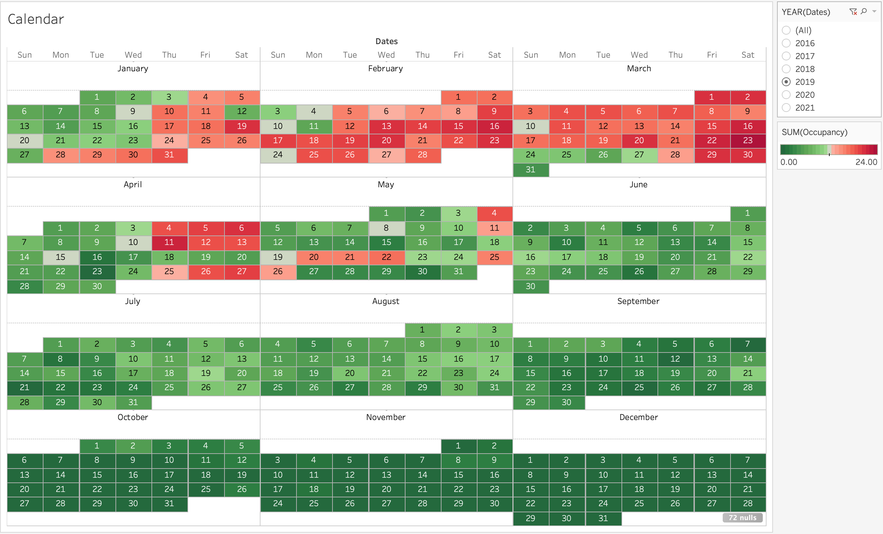
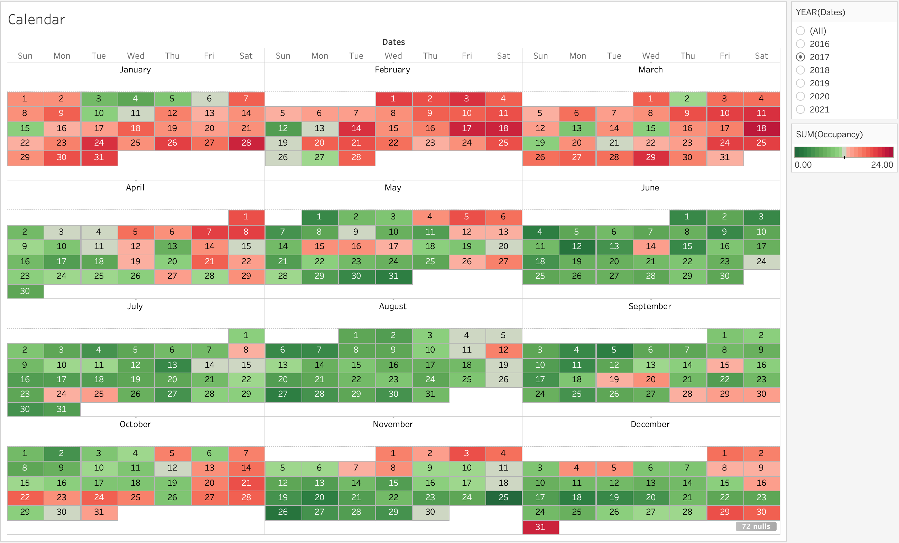
Visualizations

Slide 8
Breaking down the Data

Slide 9
2016

Slide 10
2017

Slide 11
2018

Slide 12
2019

Slide 13

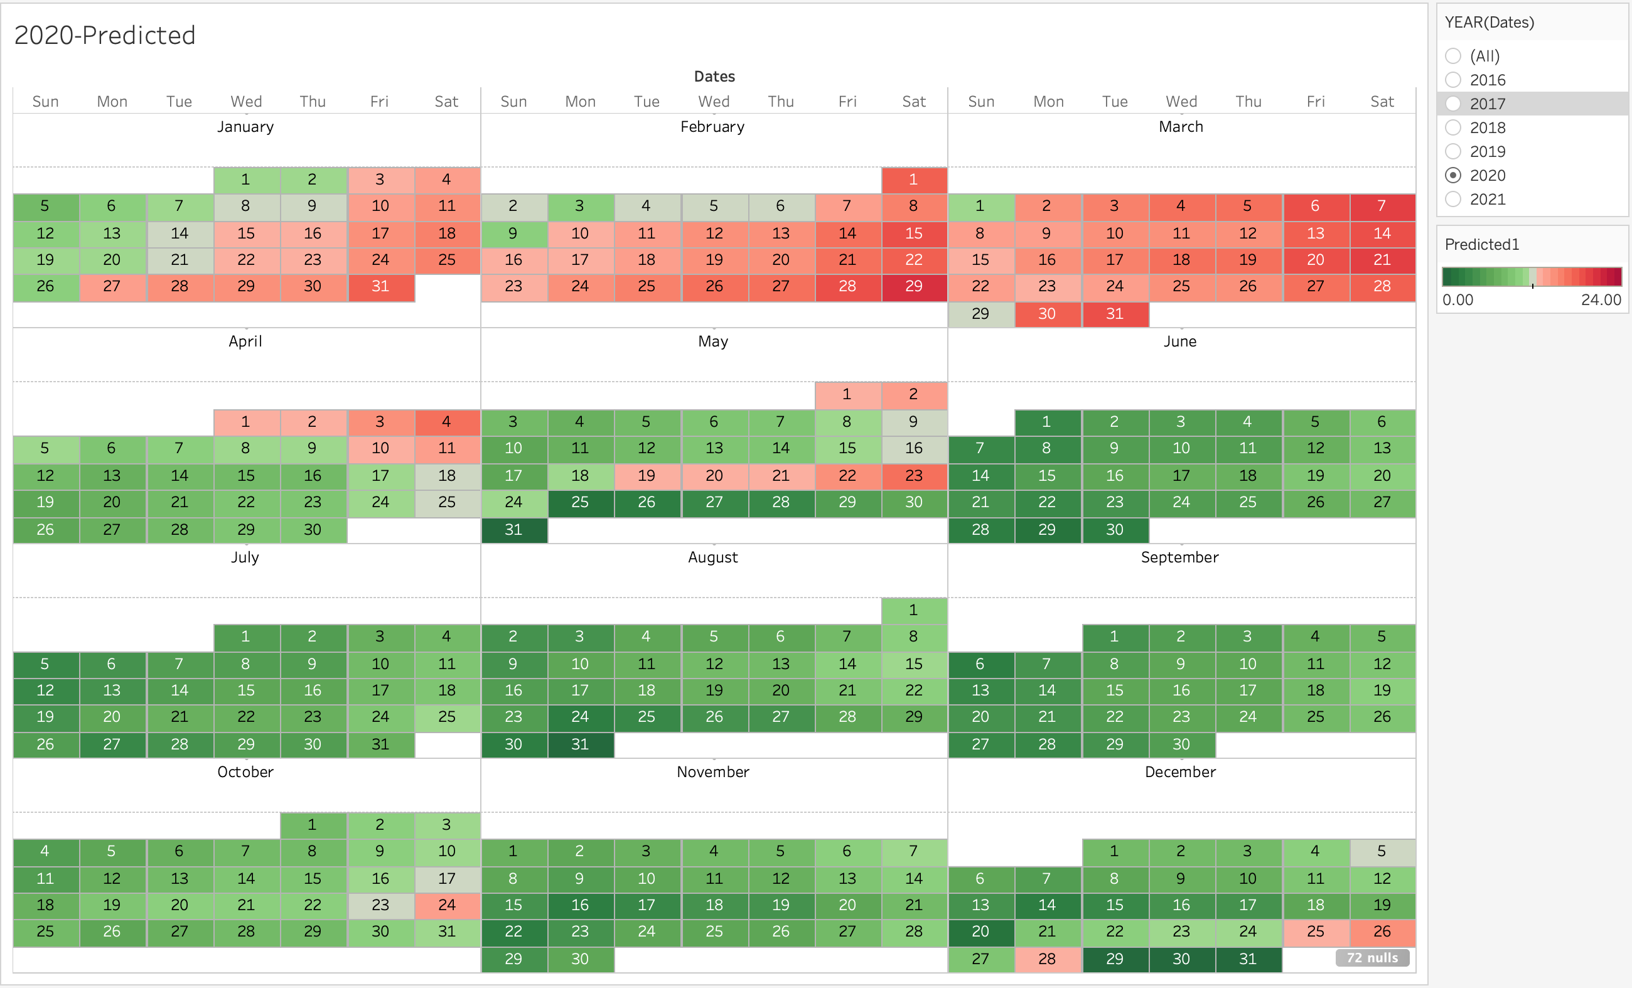
Predicting - 2020

Slide 14
2020

Slide 15
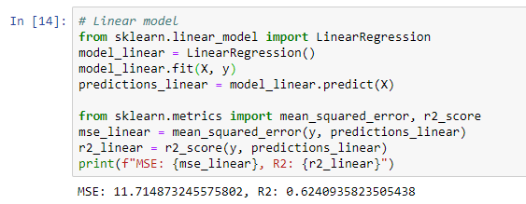
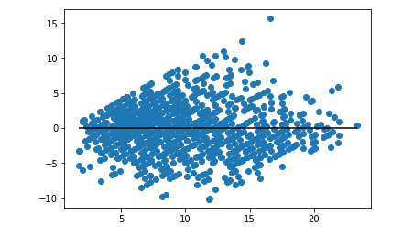
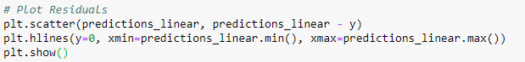
Linear Regression Model
Incorporated nearly 100 features into the model to improve the model’s accuracy

Slide 16
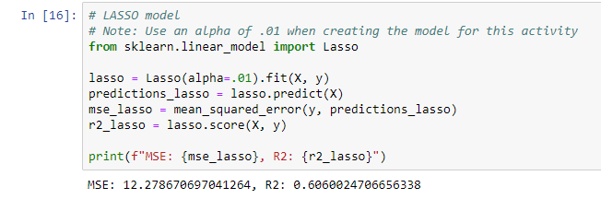
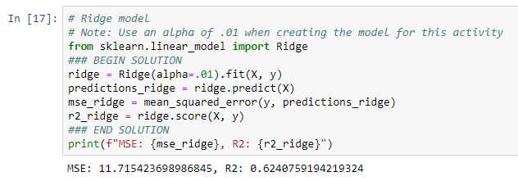
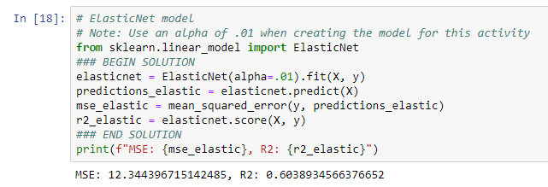
Alternative Models Explored
LASSO Model
Ridge Model
ElasticNet Model

Slide 17
Occupancy by Month

Slide 18
What else can we consider
Add events as a parameter
COACHELLA
Apr 13 - Apr 22 2018
Apr 14 - Apr 23 2017
Apr 15 - Apr 24 2016
BNP PARIBAS OPEN - INDIAN WELLS
March 5 – 18
March 6 – 19
March 9 – 20
SCRAPING DATA FROM REGIONAL HOTELS

Slide 19



